Slide 1
CSE 521 - Operating Systems Fall 2025
Lecture - 9 CPU Scheduling - I
Created by Dr. Tevfik Koşar
Presented By
Dr. Zulkar Nine

Slide 2

Roadmap
CPU Scheduling
Basic Concepts
Scheduling Criteria & Metrics
Different Scheduling Algorithms
FCFS
SJF
Priority
RR
Preemptive vs Non-preemptive Scheduling
Gantt Charts & Performance Comparison
Notes:
This is the outline of today’s class.

Slide 3
Basic Concepts
Multiprogramming is needed for efficient CPU utilization
CPU Scheduling: deciding which processes to execute when
Process execution begins with a CPU burst, followed by an I/O burst
CPU–I/O Burst Cycle – Process execution consists of a cycle of CPU execution and I/O wait

Slide 4
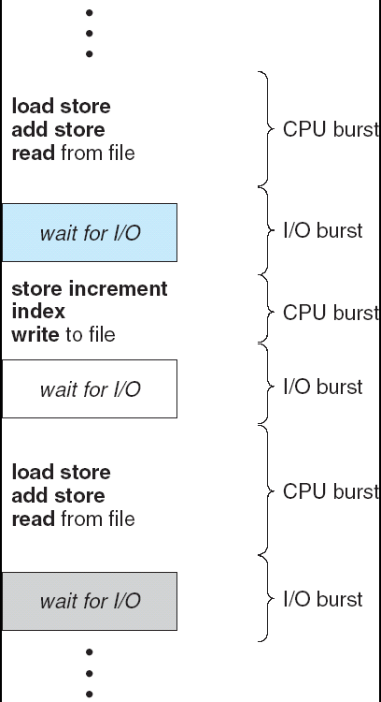
Alternating Sequence of CPU And I/O Bursts

Slide 5
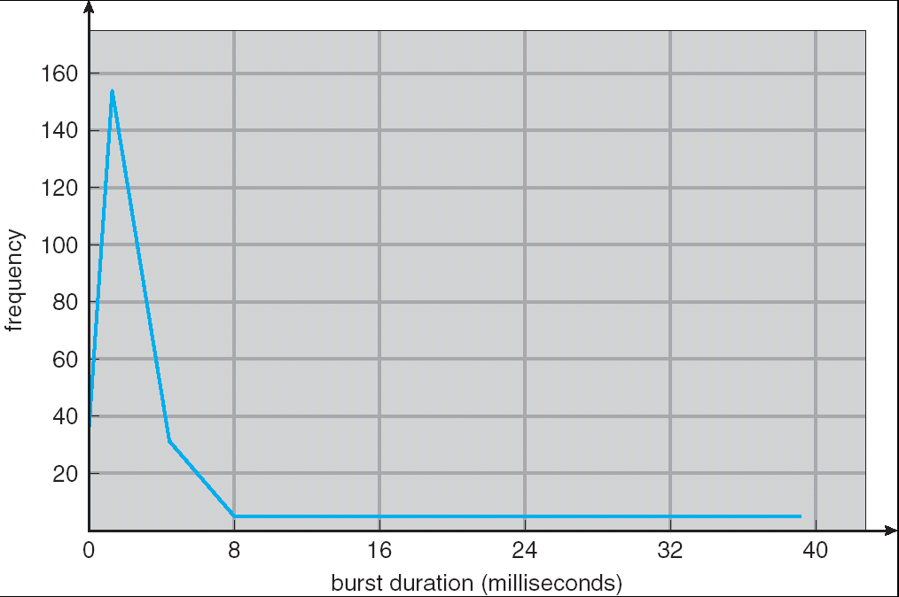
Histogram of CPU-burst Durations

Slide 6
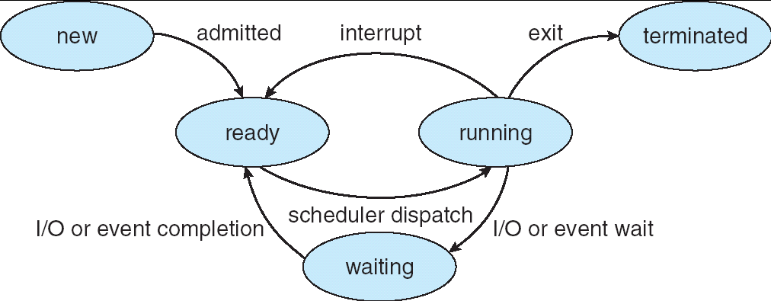
Process State
As a process executes, it changes state
new: The process is being created
ready: The process is waiting to be assigned to a process
running: Instructions are being executed
waiting: The process is waiting for some event to occur
terminated: The process has finished execution
Notes:
At any instant, only one process can be in the running state.

Slide 7
CPU Scheduler
Selects from among the processes in memory that are ready to execute, and allocates the CPU to one of them
➔ short-term scheduler
CPU scheduling decisions may take place when a process:
1. A new process arrives
2. Terminates
3. Switches from running to waiting state
4. Switches from running to ready state
5. Switches from waiting to ready
Scheduling under 2 and 3 is nonpreemptive
Once a process gets the CPU, keeps it until termination/switching to waiting state/release of the CPU
All other scheduling is preemptive
Most OS use this
Cost associated with access to shared data
i.e. time quota expires

Slide 8
Dispatcher
Dispatcher module gives control of the CPU to the process selected by the short-term scheduler;
Its function involves:
switching context
switching to user mode
jumping to the proper location in the user program to restart that program
Dispatch latency – time it takes for the dispatcher to stop one process and start another running

Slide 9
Scheduling Criteria
CPU utilization – keep the CPU as busy as possible --> maximize
Throughput – # of processes that complete their execution per time unit -->maximize
Turnaround time – amount of time passed to finish execution of a particular process --> minimize
i.e. execution time + waiting time
Waiting time – total amount of time a process has been waiting in the ready queue -->minimize
Response time – amount of time it takes from when a request was submitted until the first response is produced, not output (for time-sharing environment) -->minimize

Slide 10
Scheduling Metrics
Scheduling metrics
arrival time T_{a} = time the process became “Ready” (again)
wait time T_{w} = time spent waiting for the CPU
service time T_{s} = time spent executing in the CPU
turnaround time T_{r} = total time spent waiting and executing
= T_{w} + T_{s}
T_{a}
Arrival times
#5 arrived
T_{w}
T_{s}
Execution times
#5 executed
T_{r} / T_{s} = 2.5
T_{r}

Slide 12
First-Come, First-Served (FCFS) Scheduling
processes are assigned the CPU in the order they request it
when the running process blocks, the first “Ready” is run next
when a process gets “Ready”, it is put at the end of the queue
A
Arrival times
B
C
D
E
A
B
C
D
E
Mean
FCFS scheduling policy
Stallings, W. (2004) Operating Systems:
Internals and Design Principles (5th Edition).

Slide 13
FCFS Scheduling - Example
Process Burst Time
P₁ 24
P₂ 3
P₃ 3
Suppose that the processes arrive in the order: P₁ , P₂ , P₃
Waiting time ? Average waiting time?

Slide 15
FCFS Scheduling - Example
Suppose that the processes arrive in the order
P₂ , P₃ , P₁

Slide 17
Shortest-Job-First (SJF) Scheduling
Associate with each process the length of its next CPU burst. Use these lengths to schedule the process with the shortest time
Two schemes:
Nonpreemptive – once CPU given to the process it cannot be preempted until completes its CPU burst
preemptive – if a new process arrives with CPU burst length less than remaining time of current executing process, preempt. -->This scheme is know as the Shortest-Remaining-Time-First (SRTF)
SJF is optimal – gives minimum average waiting time for a given set of processes

Slide 19
Non-Preemptive SJF
nonpreemptive, assumes the run times are known in advance
among several equally important “Ready” jobs (or CPU bursts), the scheduler picks the one that will finish the earliest
A
Arrival times
B
C
D
E
Shortest Job First (SJF)
SJF
A
B
C
D
E
Mean
SJF scheduling policy
Stallings, W. (2004) Operating Systems:
Internals and Design Principles (5th Edition).

Slide 20
Non-Preemptive SJF - Example
Process Arrival Time Burst Time
P₁ 0.0 7
P₂ 2.0 4
P₃ 4.0 1
P₄ 5.0 4
SJF (non-preemptive) Gantt Chart

Slide 21
Preemptive SJF (SRT)
Shortest Remaining Time (SRT)
preemptive version of SJF, also assumes known run time
choose the process whose remaining run time is shortest
allows new short jobs to get good service
A
Arrival times
B
C
D
E
A
B
C
D
E
Mean
SRT scheduling policy
Stallings, W. (2004) Operating Systems:
Internals and Design Principles (5th Edition).

Slide 22
Example of Preemptive SJF
Process Arrival Time Burst Time
P₁ 0.0 7
P₂ 2.0 4
P₃ 4.0 1
P₄ 5.0 4
SJF (preemptive) Gantt Chart

Slide 23
Example of Preemptive SJF

Slide 24
Priority Scheduling
A priority number (integer) is associated with each process
The CPU is allocated to the process with the highest priority (smallest integer ≡ highest priority)
Preemptive
nonpreemptive
SJF is a priority scheduling where priority is the predicted next CPU burst time
Problem ≡ Starvation – low priority processes may never execute
Solution ≡ Aging – as time progresses increase the priority of the process

Slide 25
Example of Priority
Process Arrival Time Burst Time Priority
P₁ 0.0 7 2
P₂ 2.0 4 1
P₃ 4.0 1 4
P₄ 5.0 4 3
Priority (non-preemptive/Cooperative)
Priority (preemptive)

Slide 26
Round Robin (RR)
Each process gets a small unit of CPU time (time quantum), usually 10-100 milliseconds. After this time has elapsed, the process is preempted and added to the end of the ready queue.
If there are n processes in the ready queue and the time quantum is q, then each process gets 1/n of the CPU time in chunks of at most q time units at once. No process waits more than (n-1)q time units.
Performance
q large ⇒ FIFO
q small ⇒ q must be large with respect to context switch, otherwise overhead is too high

Slide 27
Round Robin (RR)
preemptive FCFS, based on a timeout interval, the quantum q
the running process is interrupted by the clock and put last in a FIFO “Ready” queue; then, the first “Ready” process is run instead
A
Arrival times
B
C
D
E
RR (q = 1) scheduling policy
Stallings, W. (2004) Operating Systems:
Internals and Design Principles (5th Edition).

Slide 28
Round Robin (RR)
a crucial parameter is the quantum q (generally ~10–100ms)
q should be big compared to context switch latency (~10μs)
q should be less than the longest CPU bursts, otherwise RR degenerates to FCFS
A
Arrival times
B
C
D
E
RR (q = 4) scheduling policy
Stallings, W. (2004) Operating Systems:
Internals and Design Principles (5th Edition).

Slide 29
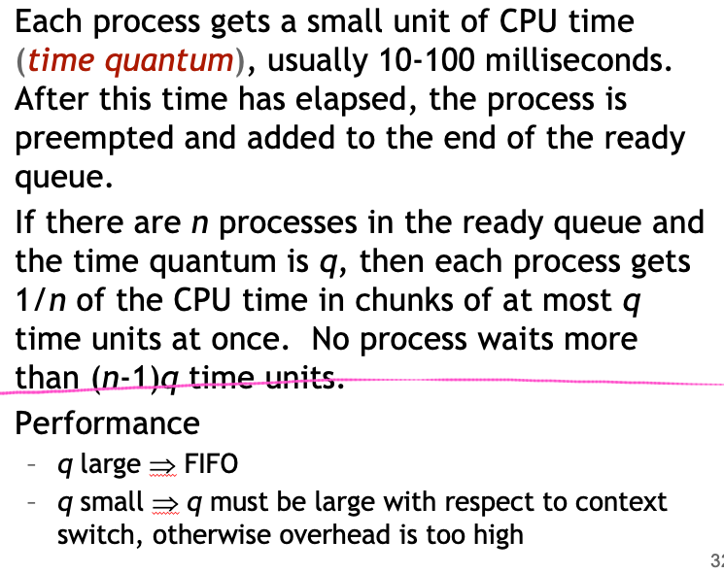
Example of RR with Time Quantum = 20
Process Burst Time
P₁ 53
P₂ 17
P₃ 68
P₄ 24
For q=20, the Gantt chart is:
Typically, higher average turnaround than SJF, but better response

Slide 30
Exercise
Consider a system using round-robin scheduling with a fixed quantum q. Every context switch takes s milliseconds. Any given process runs for an average of t milliseconds before it blocks or terminates (burst time).
Determine the fraction of CPU time that will be wasted because of context switches for each of the following cases (your answer should be in terms of q, s, and t).
a) t <= q
b) t >> q (t is much greater than q)
c) q approaches 0

Slide 31
Comparison of Scheduling Algorithms

Slide 32
FCFS
PROS:
It is a fair algorithm
schedule in the order that they arrive
CONS:
Average response time can be lousy
small requests wait behind big ones (convoy effect)
May lead to poor utilization of other resources
FCFS may result in poor overlap of CPU and I/O activity
E.g., a CPU-intensive job prevents an I/O-intensive job from doing a small bit of computation, thus preventing it from going back and keeping the I/O subsystem busy

Slide 33
SJF
PROS:
Provably optimal with respect to average waiting time
prevents convoy effect (long delay of short jobs)
CONS:
Can cause starvation of long jobs
Requires advanced knowledge of CPU burst times
this can be very hard to predict accurately!

Slide 34
Priority Scheduling
PROS:
Guarantees early completion of high priority jobs
CONS:
Can cause starvation of low priority jobs
How to decide/assign priority numbers?

Slide 35
Round Robin
PROS:
Great for timesharing
no starvation
Does not require prior knowledge of CPU burst times
Generally reduces average response time
CONS:
What if all jobs are almost time same length?
Increases the turnaround time
How to set the “best” time quantum?
if small, then context switch often, incurring high overhead
if large, then response time degrades

Slide 36
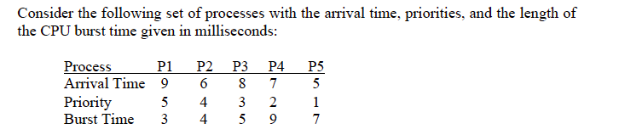
Exercise
Consider Preemptive Shortest Remaining Time First (SRTF) scheduling policy is used; a) draw the GANNT chart; b) find the response time, waiting times and turnaround time for each process.

Slide 37
Exercise
Draw gantt charts, find average turnaround, waiting, and response times for above processes, considering:
1) First Come First Served Scheduling
2) Shortest Job First Scheduling (non-preemptive)
3) Shortest Job First Scheduling (preemptive)
4) Round-Robin Scheduling (q=4)
5) Priority Scheduling (non-preemptive)
6) Priority Scheduling (preemptive)

Slide 38
Summary
CPU Scheduling
Basic Concepts
Scheduling Criteria & Metrics
Different Scheduling Algorithms
FCFS
SJF
Priority
RR
Comparison of Algorithms
Hmm..

Slide 39
Acknowledgements
“Operating Systems Concepts” book and supplementary material by A. Silberschatz, P. Galvin and G. Gagne
“Operating Systems: Internals and Design Principles” book and supplementary material by W. Stallings
“Modern Operating Systems” book and supplementary material by A. Tanenbaum
R. Doursat and M. Yuksel from UNR

